Slide 1
Exploit, CVE, CVSS, VAPT and Automation Tools
Lecture 10

Slide 2
What is Exploit
In short, an exploit is a piece of software or code that takes advantage of a vulnerability in a computer system or software to carry out a specific malicious action, such as gaining unauthorized access or running malicious code. Exploits are used by hackers to compromise the security of a target system.

Slide 3
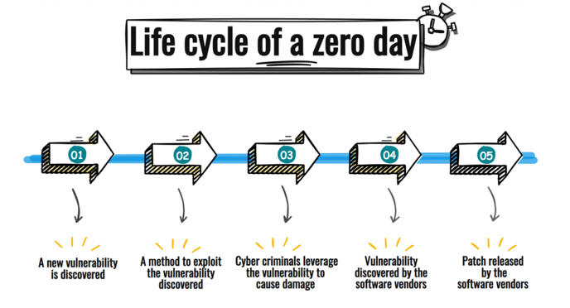
Types of Exploit
Zero-Day Exploit: Also called unknown exploit, a zero-day exploit targets a vulnerability that is not publicly known, giving the targeted software or hardware vendor "zero days" to address and patch the issue. These exploits are used before a fix is available, making them highly effective and valuable.

Slide 4
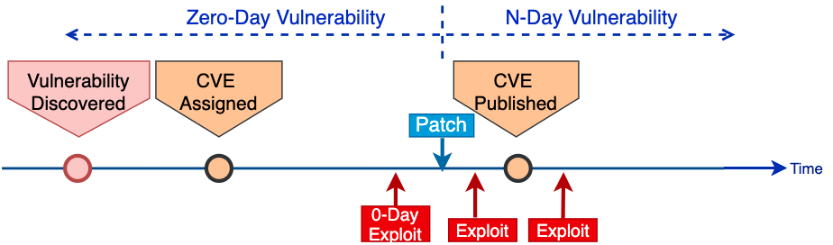
Types of Exploit
One-Day Exploit: A one-day exploit is similar to a zero-day, but it is used shortly after a vulnerability becomes publicly known or after a patch is released. It takes advantage of the brief window of opportunity when organizations may not have applied the patch.

Slide 5
What is VAPT
Vulnerability Assessment and Penetration Testing (VAPT) is a security testing method that combines two key components:
Vulnerability Assessment (VA): Identifies potential weaknesses and vulnerabilities in computer systems and networks.
Penetration Testing (PT): Involves actively attempting to exploit identified vulnerabilities to assess their real-world impact.
VAPT helps organizations find and address security issues to protect their digital assets from cyber threats.

Slide 6
Vulnerability Assessment
Vulnerability Assessment focuses on detecting vulnerabilities and flag them for further review by security teams. Vulnerability Assessment tools are usually automated and scan for known vulnerabilities within the system.
Activities of vulnerability assessment includes:
Asset Discovery: Identify all system, software, device and network components
Vulnerability Scanning: Use automated tools to scan and identify vulnerabilities
Risk Evaluation: Assign severity (CVSS) to assess impact and exploitability
Reporting: Document findings with associated CVE and CVSS
Remediation Planning: Provide recommendations based on overall findings

Slide 7

What is a CVE
A CVE, or Common Vulnerabilities and Exposures, is a standardized identifier for a known security vulnerability or exposure in software or hardware products. CVEs are used to uniquely identify and reference vulnerabilities, making it easier for cybersecurity professionals, vendors, and organizations to share information about security issues and coordinate efforts to mitigate them.
Each CVE entry is assigned a unique identifier, typically in the format "CVE-YYYY-NNNN," where "YYYY" represents the year of assignment, and "NNNN" is a unique number for that year.

Slide 8
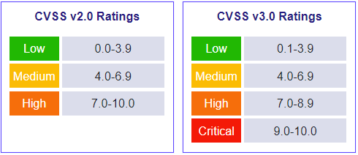
What is a CVSS
The Common Vulnerability Scoring System (CVSS) is a free and open industry standard for assessing the severity of computer system security vulnerabilities.

Slide 9
Vulnerability Assessment Report
A vulnerability assessment report is a document that records all the vulnerabilities found in the systems during a vulnerability scan. The report provides a list of the vulnerabilities indexed by severity along with suggestions for fixing the vulnerabilities.
Components of a vulnerability assessment report includes:
1. The Executive Summary
2. Details of the vulnerabilities
3. Details of the scans
Example of a vulnerability assessment report:
https://www.getastra.com/blog/wp-content/uploads/2021/06/Astra-Security-Sample-VAPT-Report.pdf

Slide 10
Penetration Testing
Penetration Testing (also called Pentesting) is a complementary step for Vulnerability Assessment where security experts perform simulated attacks on the system, mimicking the behavior of malicious hackers. This is usually conducted by third-party security experts, providing an outsider’s perspective on the system’s security.
Pentesters look for both known and unknown vulnerabilities using both manual and automated tools. This provides in-depth understanding of potential hacking techniques attackers might use.

Slide 11
VAPT Types
There are several types of VAPT (Vulnerability Assessment and Penetration Testing) that can be performed, depending on the specific goals and focus areas. Here are some common types of VAPT:
1. Network Vulnerability Assessment and Penetration Testing: This focuses on identifying and addressing vulnerabilities in a network infrastructure, including routers, switches, firewalls, and other devices. The testing involves assessing network services, configurations, and potential weaknesses.
2. Web Application Vulnerability Assessment and Penetration Testing: This targets web applications to identify vulnerabilities such as SQL injection, cross-site scripting (XSS), and other web-specific issues. It aims to secure web applications against attacks.

Slide 12
VAPT Types
3. Cloud Security Assessment and Penetration Testing: Focuses on cloud environments and services, such as Amazon Web Services (AWS), Microsoft Azure, or Google Cloud. It checks for misconfigurations, vulnerabilities, and security best practices within cloud deployments.
4. Mobile Application Vulnerability Assessment and Penetration Testing: For mobile apps, this type of testing uncovers security weaknesses specific to iOS and Android applications. It checks for issues like insecure data storage, improper authentication, and more.

Slide 13
Questions

Slide 14
Thanks!

